Slide 1

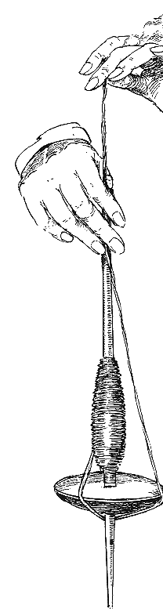

PROVIDING ADVANCED YARN SOLUTIONS
Plot No- 145, Sector 21, Phase - 1, HSIIDC, Barhi, Sonipat - 131101, Haryana, India
Mob: +91-9871554904, +91 9996625050
E-mail: info@hpt-india.com
www.hpt-india.org
HIGH PERFORMANCE TEXTILES PRIVATE LIMITED

Slide 2





About Us :
Providing Advanced Yarn Solutions
A yarn designing and manufacturing company based in India (Sonipat, Panipat).
Yarns manufactured by blending fibres & filaments as per end-user requirements.
Spinning technologies available in India:-
Hollow spindle;
Drafting hollow spindle;
Ring spinning;
TFO twister;
Winder and splicer.
HIGH PERFORMANCE TEXTILES PRIVATE LIMITED
Office Address : Plot No- 145, Sector 21, Phase - 1, HSIIDC, Barhi, Sonipat - 131101, Haryana, India
www.hpt-india.com

Slide 3

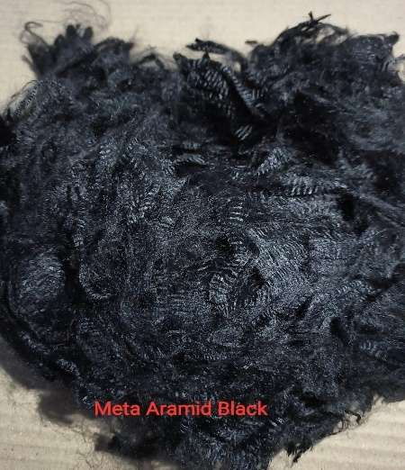
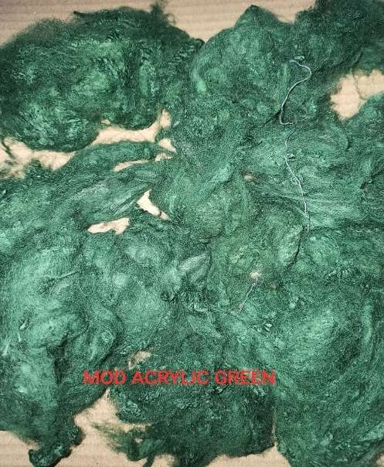
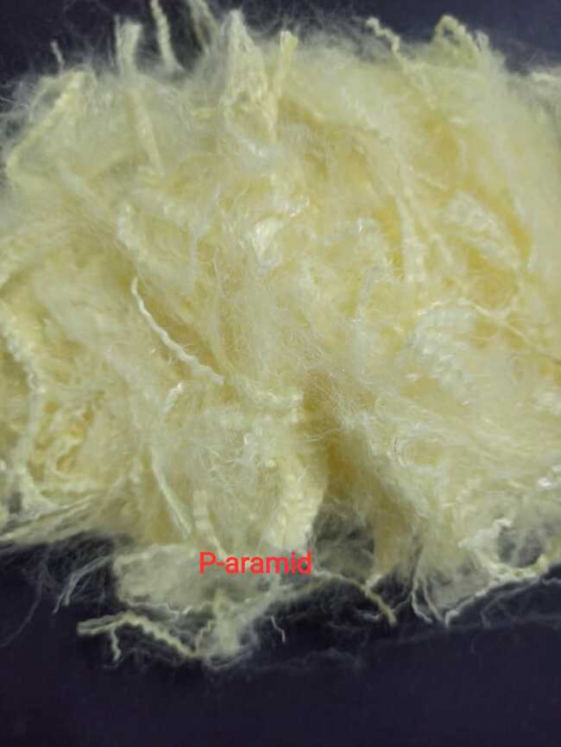
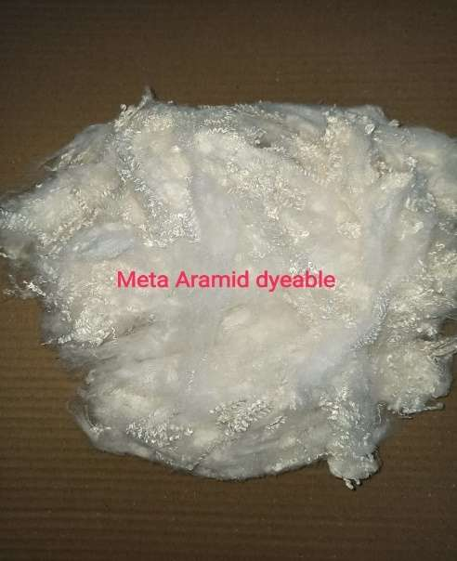
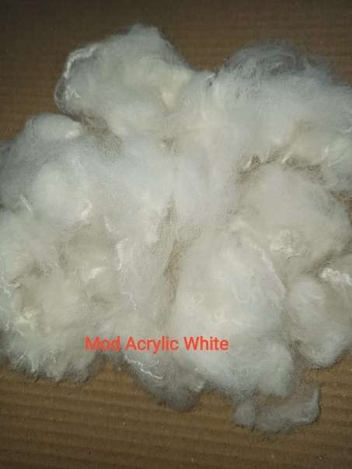
Technical Yarns: IFR Staple fibres
HIGH PERFORMANCE TEXTILES PRIVATE LIMITED
Office Address : Plot No- 145, Sector 21, Phase - 1, HSIIDC, Barhi, Sonipat - 131101, Haryana, India
www.hpt-india.com

Slide 4
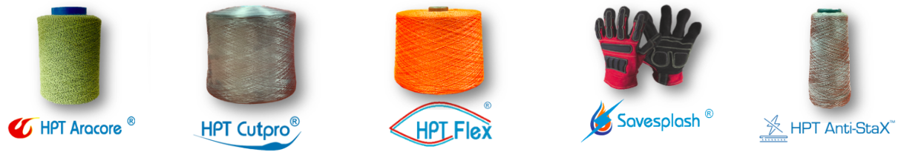
HPT Yarns
    HPT Aracore® – Aramid based heat & cut-resistant yarns;
    HPT Flex ® - High performance polyethylene (UHMWPE) based cut/slash/stab resistant yarns;
    HPT CutPro® - Cut-resistant comfort yarns;
    HPT Savesplash® - Yarns for protection against electric arc-flash and flash fire;
    HPT Anti-StaX™ - Yarns with low surface resistance (Ω) for protection against electrostatic charges.
HIGH PERFORMANCE TEXTILES PRIVATE LIMITED
Office Address : Plot No- 145, Sector 21, Phase - 1, HSIIDC, Barhi, Sonipat - 131101, Haryana, India
www.hpt-india.com

Slide 5
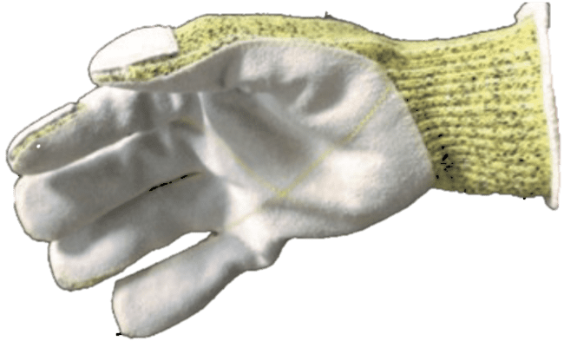
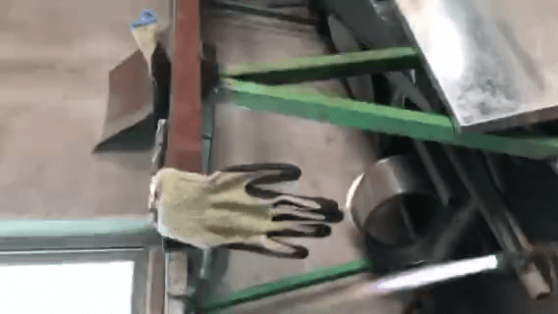
The HPT Aracore® yarns* are designed to provide maximum protection against thermal (vertical flammability, contact, convective and radiant heat, small splashes of molten metals) and mechanical hazards (cut, slash, lacerations).
Manufactured using ‘Inherent’ flame-retardant fibres such as:-
para-aramid – e.g. Kevlar®, Heracron®, Twaron®;
meta-aramid – e.g. Nomex®, Toray, SRO;
Modacrylic – e.g. Protex®, Formosa;
FR-Viscose – e.g. Lenzing FR viscose, Waxman FR viscose, Viscont® FR;
Pre-oxidised acrylic (PAN) – e.g. Panox®, Pyronex®
HPT Aracore®yarns are used to manufacture:
Seamless gloves
Cut and sewn gloves
Balaclava
Work wear
Aprons
Sleeves
Socks
Applications:
Steel handling
Foundries
Welding
Plastic industry
Lathe operations
Metal grinding/ filing
Mining, Ceramic industry
*Indian Provisional Patent Application No. 202011004920, Balanced Ring Spun Core Yarn
HIGH PERFORMANCE TEXTILES PRIVATE LIMITED
Office Address : Plot No- 145, Sector 21, Phase - 1, HSIIDC, Barhi, Sonipat - 131101, Haryana, India
www.hpt-india.com

Slide 6
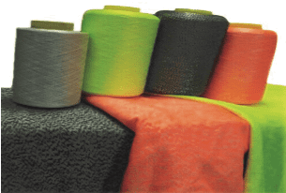
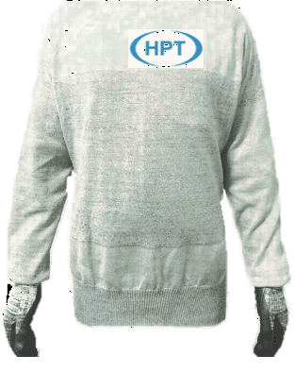

The HPT Flex® yarns are designed to provide maximum protection against cut, slash, lacerations at a room temperature.
Manufactured using high performance polyethylene fibres in combination with e-glass, stainless steel wire, nylon, polyester.
HPT Flex ®yarns are used to manufacture PPT such as:
Seamless gloves
Cut and sewn gloves
Balaclava
Work wear
Aprons
Sleeves
T-Shirts
Applications:
Meat Processing
Commercial Fishing
Plastic Industry
Glass Industry
Automotive Assembly
Body Shop
Light Metal Handling
Maintenance and Machining
HIGH PERFORMANCE TEXTILES PRIVATE LIMITED
Office Address : Plot No- 145, Sector 21, Phase - 1, HSIIDC, Barhi, Sonipat - 131101, Haryana, India
www.hpt-india.com

Slide 7


The HPT Cutpro® yarns are designed to provide basic protection against cut and slash.
Manufactured using acrylic, polyester, nylon, cotton reinforced with e-glass, stainless steel wires, HPPE filaments in core to provide comfort alongwith protection against cut, slash and lacerations.
‘Inherent’ anti-bacterial fibres are also blended in these yarns to provide protection against Staphylococcus aureus and Klebsiella pneumoniae bacteria. The end products are also resistant to fungul attack as per AATCC 30:III 2003.
HPT Cutpro®yarns are used to manufacture PPT such as:
Seamless gloves
Cut and sewn gloves
Balaclava
Work wear
Aprons
Sleeves
Socks
Applications:
Glass Industry
Metal Handling
Stamping Operations
Body Shop
Paint Shop
General Handling
Waste Handlaing
HIGH PERFORMANCE TEXTILES PRIVATE LIMITED
Office Address : Plot No- 145, Sector 21, Phase - 1, HSIIDC, Barhi, Sonipat - 131101, Haryana, India
www.hpt-india.com

Slide 8

The HPT Savesplash® yarn/fabrics* are designed to provide protection against electric arc flash fire.
Manufactured using p-aramid fibres blended with other high performance fibres.
Colours available: Maroon, Orange and Black.
Electric Arc-flash fire protection (HRC level 2, 3 and 4) as per ASTM F1959/F 1959M-14.
HPT Savesplash®yarns are used to manufacture PPT such as:
Cut and sewn gloves
Balaclava
Work wear
Aprons
Sleeves
Socks
Applications:
Oil and Gas Industry
Mining
Maintenance of de-energized electrical panels
Emergency Services
Machinery Maintenance
*Indian Provisional Patent Application No. 201911016122, Innovative Textiles for Personal Protection
HIGH PERFORMANCE TEXTILES PRIVATE LIMITED
Office Address : Plot No- 145, Sector 21, Phase - 1, HSIIDC, Barhi, Sonipat - 131101, Haryana, India
www.hpt-india.com

Slide 9

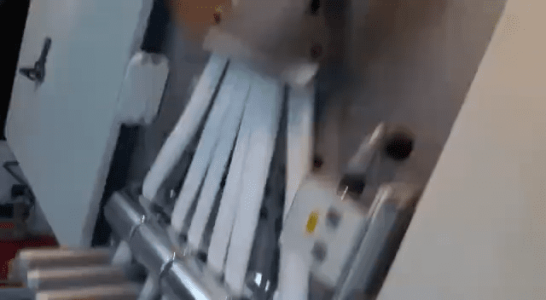
HPT Anti-StaX™ yarns are manufactured using innovative spinning technique where core conductive fibers are blended with polyester, polypropylene, aramid, nylon fibers to achieve required range of surface resistance in the finished product. These yarns can be used for weaving, knitting and braiding applications and the finished products are used to control static discharge which can damage electronic equipment and can also cause a static shock and electrostatic discharge (ESD) leading to industrial explosion.
HPT Anti-StaX™ yarns are used to manufacture antistatic textiles e.g.
Seamless gloves
Socks
Balaclava
Workwear
Aprons
Sleeves
Applications:
Electronic equipment handling
Oil & gas industry
Industrial dust filters
Automotive dust separators
Mining sleeves
HIGH PERFORMANCE TEXTILES PRIVATE LIMITED
Office Address : Plot No- 145, Sector 21, Phase - 1, HSIIDC, Barhi, Sonipat - 131101, Haryana, India
www.hpt-india.com

Slide 10
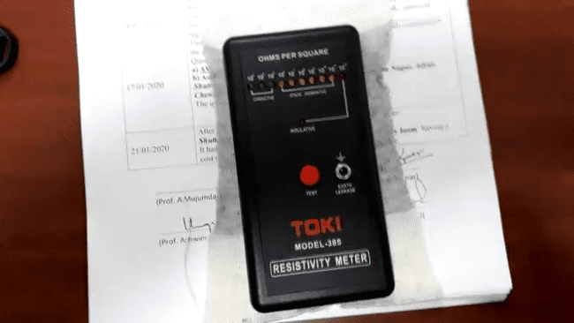
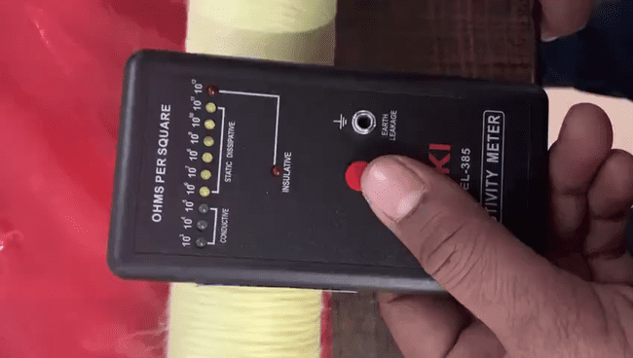
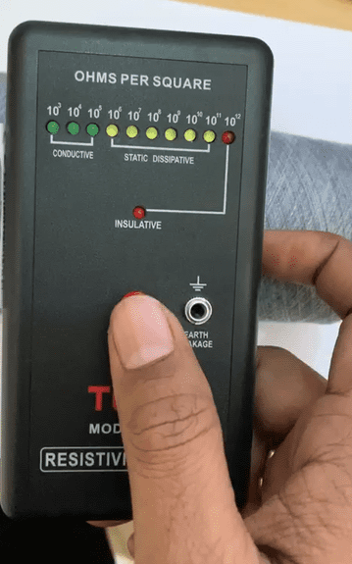
Case Study 5:
Development of HPT Anti-StaX™ yarns
HIGH PERFORMANCE TEXTILES PRIVATE LIMITED
Office Address : Plot No- 145, Sector 21, Phase - 1, HSIIDC, Barhi, Sonipat - 131101, Haryana, India
www.hpt-india.com
Notes:
Video of Anti-staX measurement and processing

Slide 11

Thank you!
Dr. Nandan Kumar,
Director, HPT Pvt. Ltd.
nandan@hpt-india.com
HIGH PERFORMANCE TEXTILES PRIVATE LIMITED
Office Address : Plot No- 145, Sector 21, Phase - 1, HSIIDC, Barhi, Sonipat - 131101, Haryana, India
www.hpt-india.com

